Slide 1
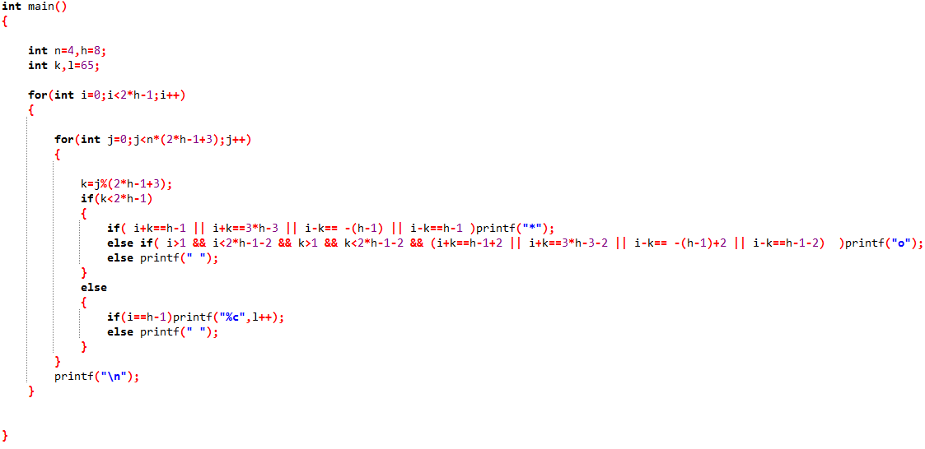
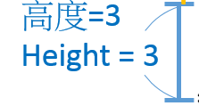
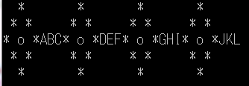
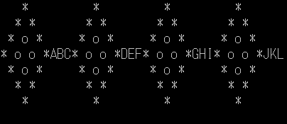
0 1 2 3 4 5 6 7 0 1 2 3….
i
k
* ( i-2, k+2 )
* ( i-1, k+1 )
* ( i, k )

